Slide 1
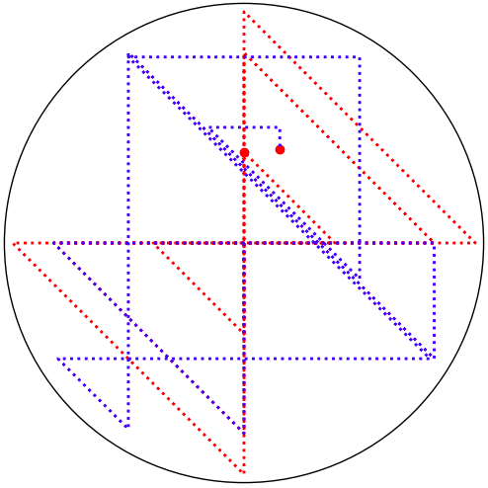
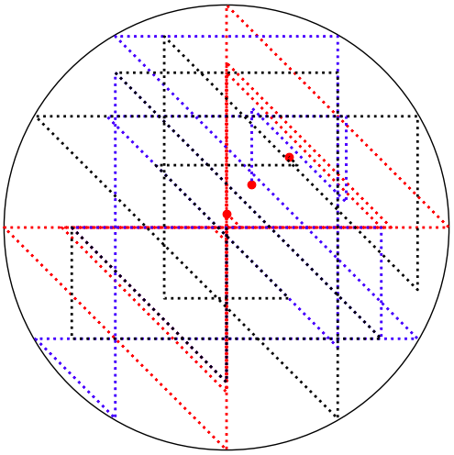
A dynamical system with two (or three, or more) billiard balls
Darryl Nester
Bluffton University
Miami University
Mathematics Conference
September 29, 2023

Slide 2
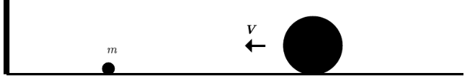
Abstract
In Gregory Galperin’s 2003 paper Playing Pool with π, he described a simple dynamical system: two unequal masses on a one-dimensional “billiard table” modeled by the interval [0,∞), with a “wall” at x=0. The masses undergo perfectly elastic collisions (conserving energy and momentum) with each other and with the wall. He proved that the total number of collisions has a surprising connection to the digits of π. We’ll review his proof, and explore what happens when there are more masses involved.

Slide 3
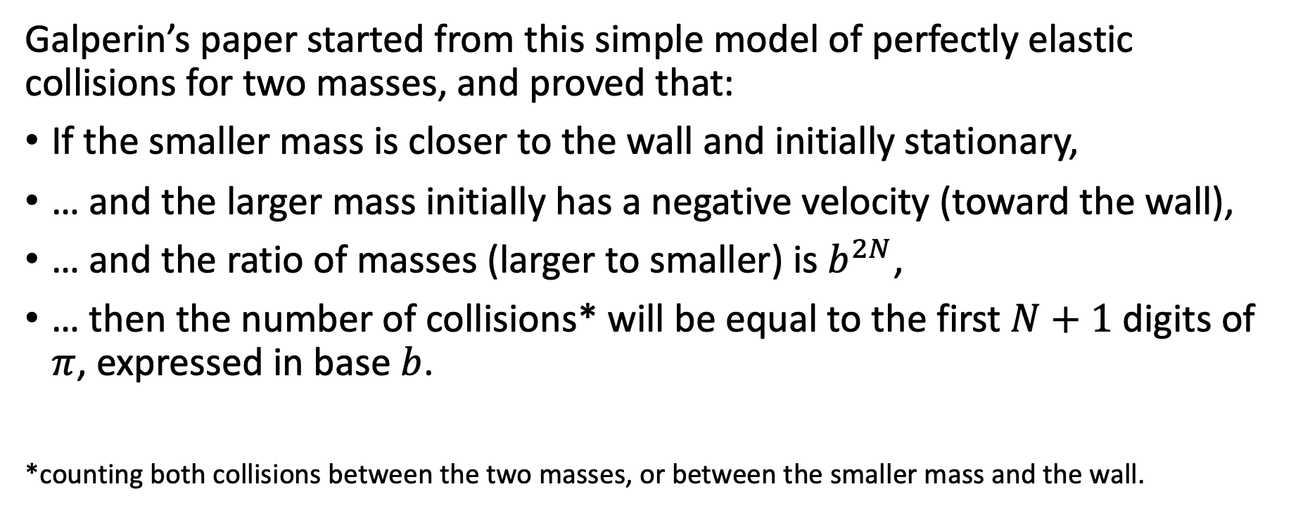
A quick summary of Galperin …
Galperin’s paper started from this simple model of perfectly elastic collisions for two masses, and proved that:
If the smaller mass is closer to the wall and initially stationary,
… and the larger mass initially has a negative velocity (toward the wall),
… and the ratio of masses (larger to smaller) is $b^{2N}$,
… then the number of collisions* will be equal to the first $N+1$ digits of $π$, expressed in base $b$.
*counting both collisions between the two masses, or between the smaller mass and the wall.

Slide 4
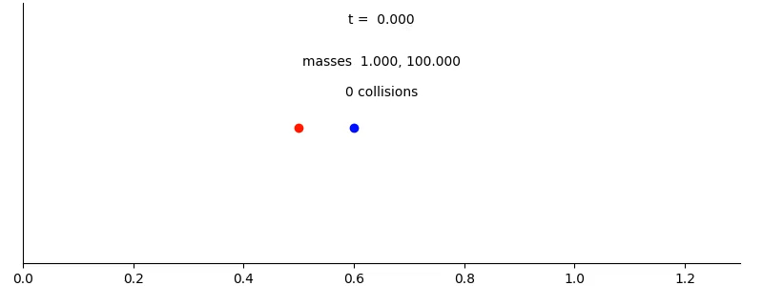
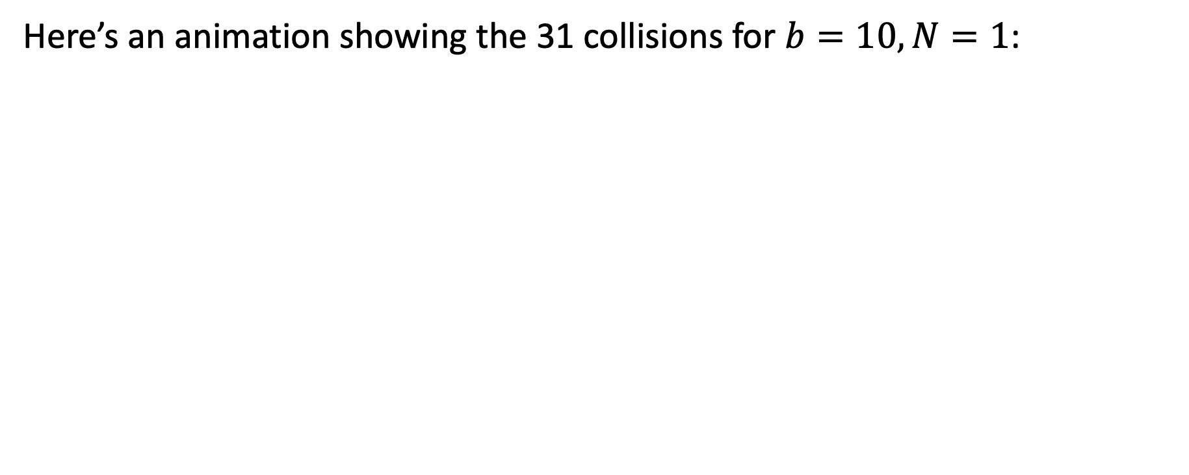
A quick summary of Galperin …
Here’s an animation showing the 31 collisions for $b=10, N=1$:

Slide 5
A quick summary of Galperin …
In his closing remarks, Galperin noted:
When the procedure was presented to the audience, no one believed it at ﬁrst, but then the author gave a proof, the ease of which convinced everyone. [In later presentations, he observed] the same reaction of the audience: ﬁrst complete distrust and then complete acceptance, due to the obviousness of the proof. [emphasis added]
Galperin’s proof recasts the problem in a way that we only need to consider the positions of the balls—essentially ignoring the velocities.
This alternative proof only considers the velocities; this will be more useful when we generalize the problem to three or more masses.

Slide 6
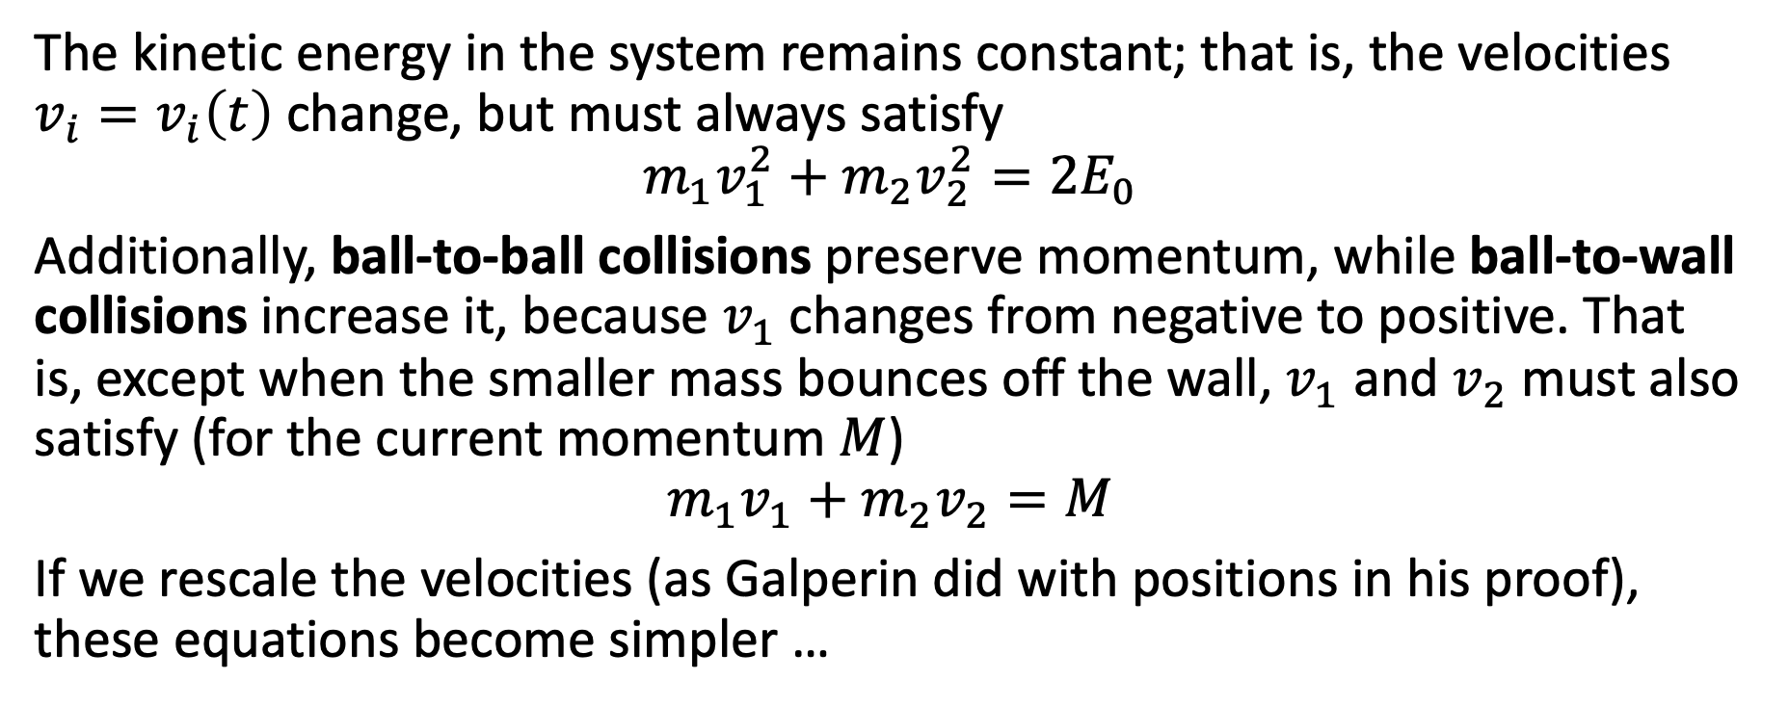
A proof using a velocity phase plane
The kinetic energy in the system remains constant; that is, the velocities $v_{i}=v_{i}\left(t\right)$change, but must always satisfy
$$m_{1}v_{1}^{2}+m_{2}v_{2}^{2}={2E}_{0}$$
Additionally, ball-to-ball collisions preserve momentum, while ball-to-wall collisions increase it, because $v_{1}$changes from negative to positive. That is, except when the smaller mass bounces off the wall, $v_{1}$ and $v_{2}$ must also satisfy (for the current momentum $M$)
$$m_{1}v_{1}+m_{2}v_{2}=M$$
If we rescale the velocities (as Galperin did with positions in his proof), these equations become simpler …

Slide 7
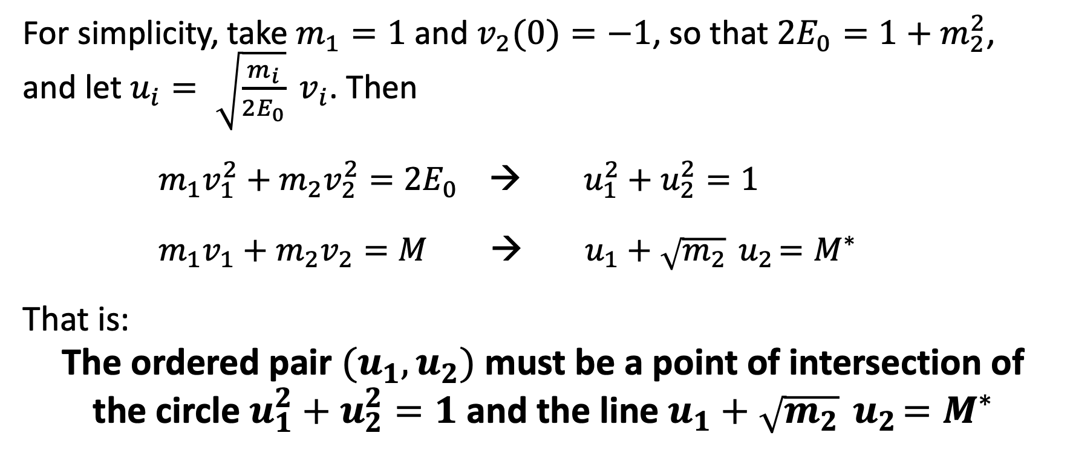
A proof using a velocity phase plane
For simplicity, take $m_{1}=1$ and $v_{2}(0)=−1$, so that ${2E}_{0}=1+m_{2}^{2}$,
and let $u_{i}= \sqrt{\frac{m_{i}}{2E_{0}}} v_{i}$. Then
$m_{1}v_{1}^{2}+m_{2}v_{2}^{2}={2E}_{0}$ → $u_{1}^{2}+u_{2}^{2}=1$
$m_{1}v_{1}+m_{2}v_{2}=M$ → $u_{1}+\sqrt{m_{2}}{ u}_{2}=M^{∗}$
That is:
The ordered pair $(u_{1},u_{2})$ must be a point of intersection of
the circle $u_{1}^{2}+u_{2}^{2}=1$ and the line $u_{1}+\sqrt{m_{2}}{ u}_{2}=M^{∗}$

Slide 8
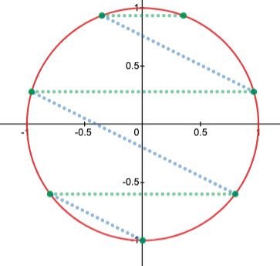
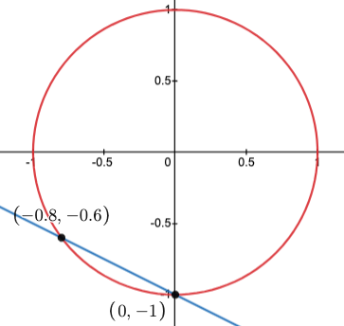
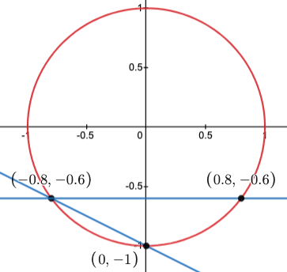
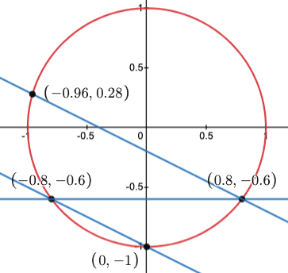
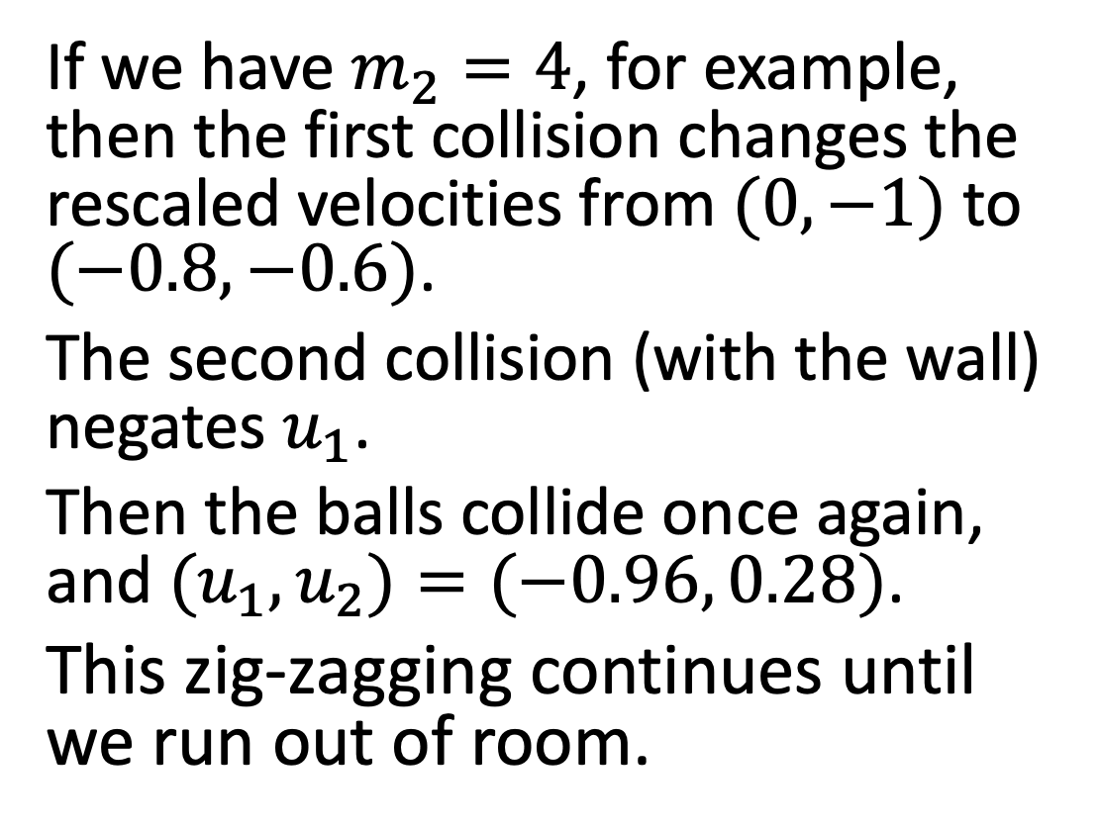
A proof using a velocity phase plane
If we have $m_{2}=4$, for example, then the first collision changes the rescaled velocities from $(0,−1)$to $(−0.8, −0.6)$.
The second collision (with the wall) negates $u_{1}$.
Then the balls collide once again, and $(u_{1},u_{2})=(−0.96, 0.28)$.
This zig-zagging continues until we run out of room.

Slide 9
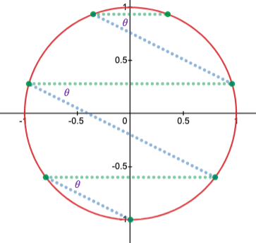
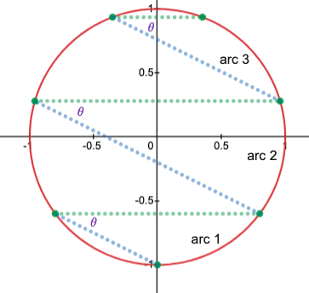
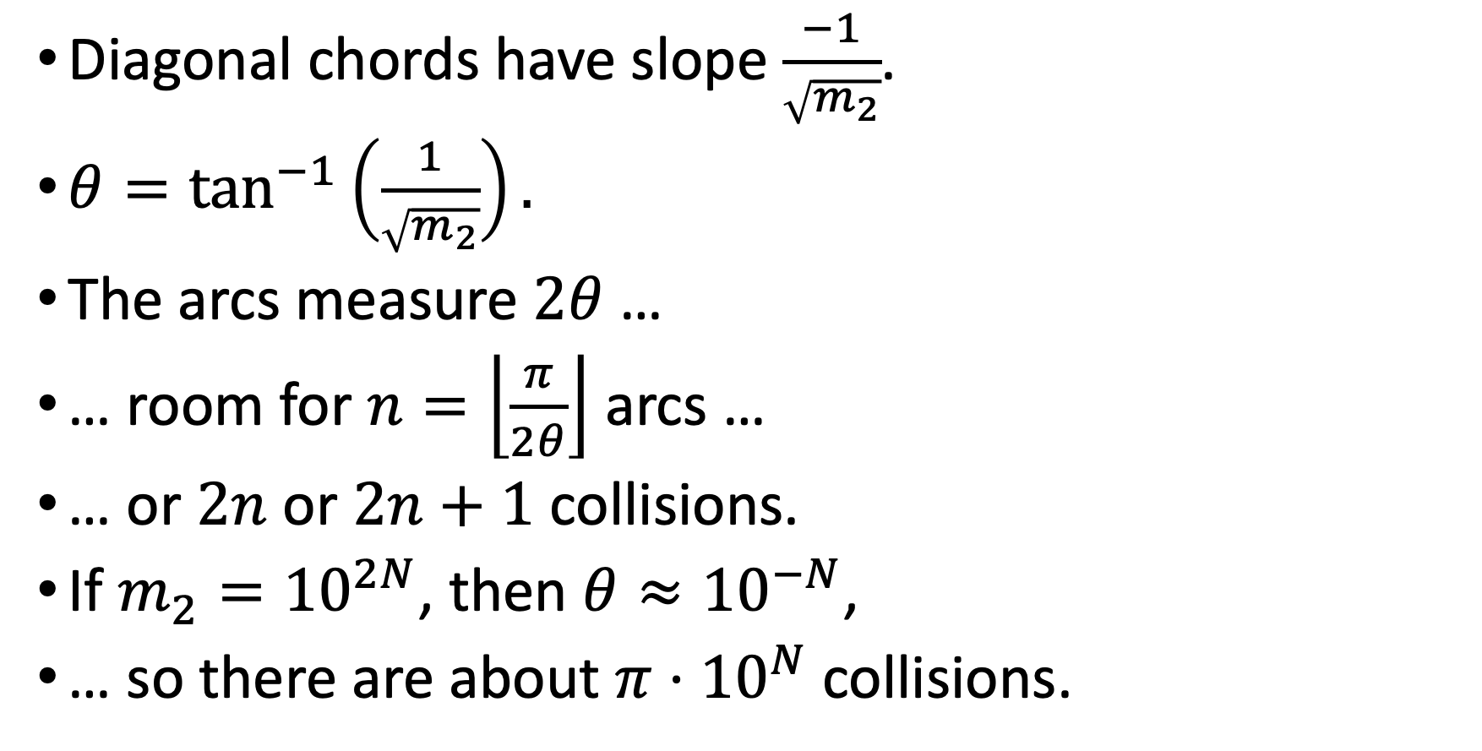
How many zig-zags can we fit on the circle?
Diagonal chords have slope $\frac{−1}{\sqrt{m_{2}}}$.
${θ=tan}^{−1}\left(\frac{1}{\sqrt{m_{2}}}\right).$
The arcs measure $2θ$ …
… room for $n=\left\lfloor \frac{π}{2θ}\right\rfloor$ arcs …
… or $2n$ or $2n+1$ collisions.
If $m_{2}={10}^{2N}$, then $θ≈{10}^{−N}$,
… so there are about $π⋅{10}^{N}$ collisions.

Slide 10
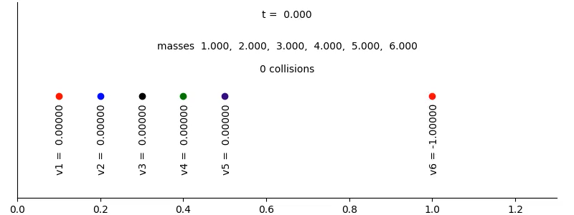
Three or more masses
If we throw some more masses into the system, it obviously gets more complicated:

Slide 11
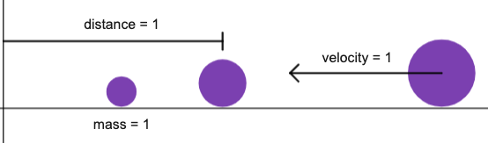
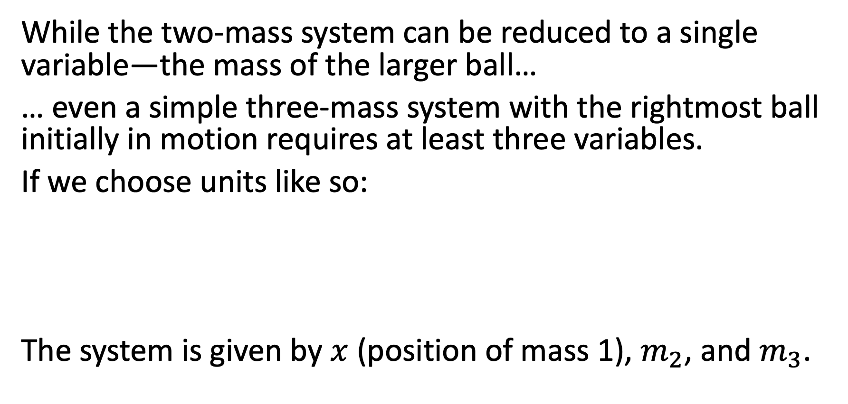
Analysis for three masses
While the two-mass system can be reduced to a single variable—the mass of the larger ball…
… even a simple three-mass system with the rightmost ball initially in motion requires at least three variables.
If we choose units like so:
The system is given by $x$ (position of mass 1), $m_{2}$, and $m_{3}$.

Slide 12
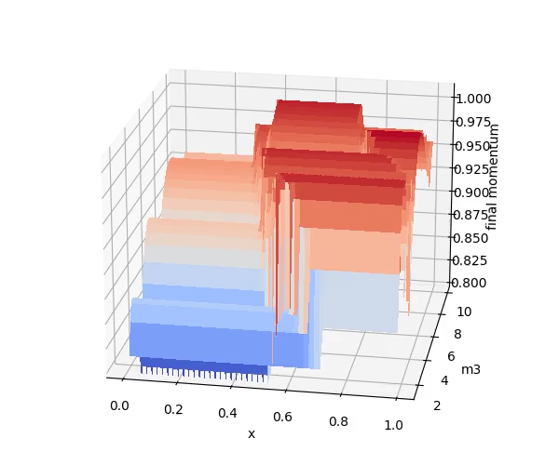
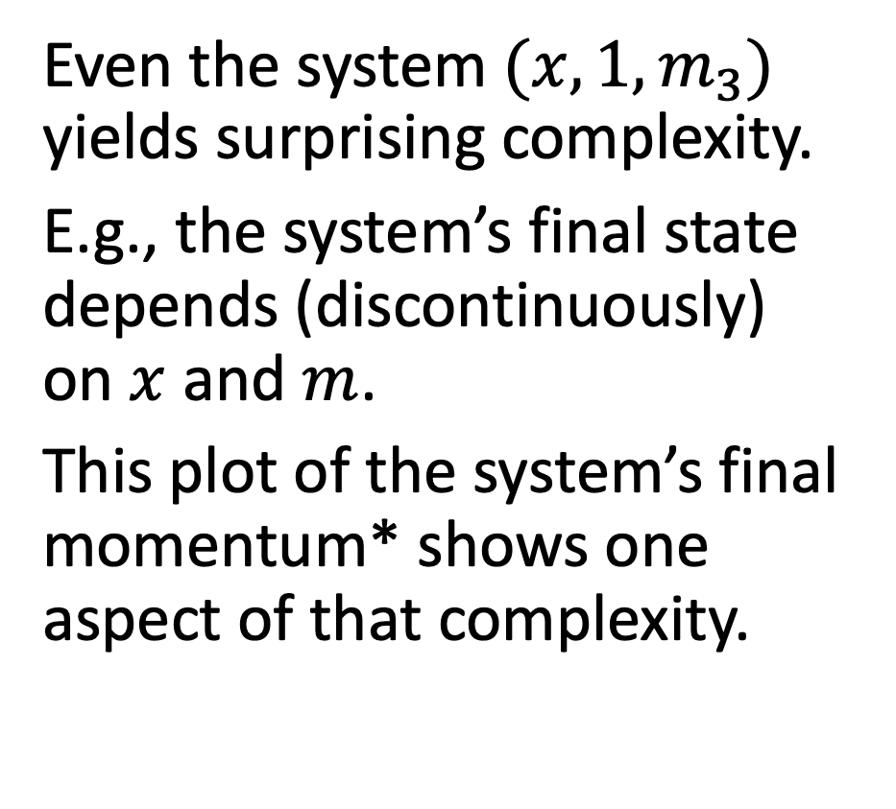
Analysis for three masses
Even the system $(x,1,m_{3})$ yields surprising complexity.
E.g., the system’s final state depends (discontinuously) on $x$ and $m$.
This plot of the system’s final momentum* shows one aspect of that complexity.

Slide 13
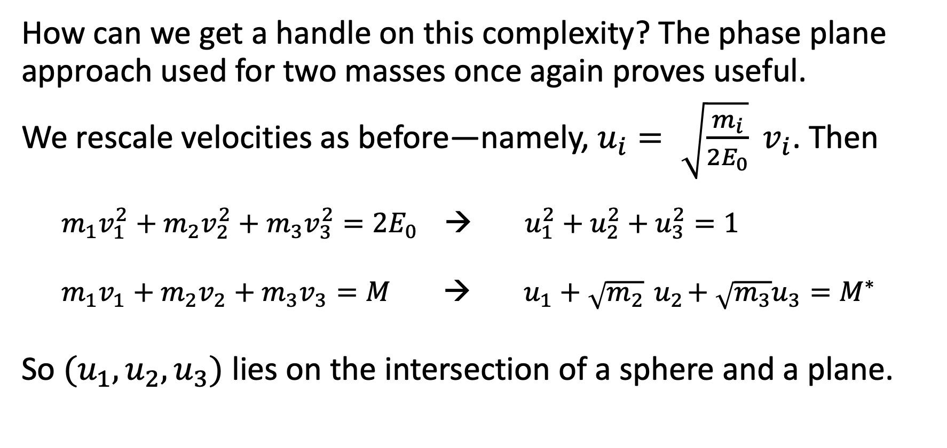
Analysis for three masses
How can we get a handle on this complexity? The phase plane approach used for two masses once again proves useful.
We rescale velocities as before—namely, $u_{i}= \sqrt{\frac{m_{i}}{2E_{0}}} v_{i}$. Then
$m_{1}v_{1}^{2}+m_{2}v_{2}^{2}+m_{3}v_{3}^{2}={2E}_{0}$ → $u_{1}^{2}+u_{2}^{2}+u_{3}^{2}=1$
$m_{1}v_{1}+m_{2}v_{2}+m_{3}v_{3}=M$ → $u_{1}+\sqrt{m_{2}}{ u}_{2}+\sqrt{m_{3}}u_{3}=M^{∗}$
So $(u_{1},u_{2},u_{3})$ lies on the intersection of a sphere and a plane.

Slide 14
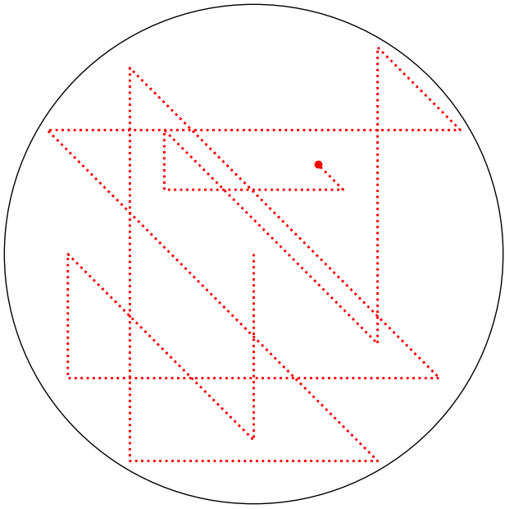
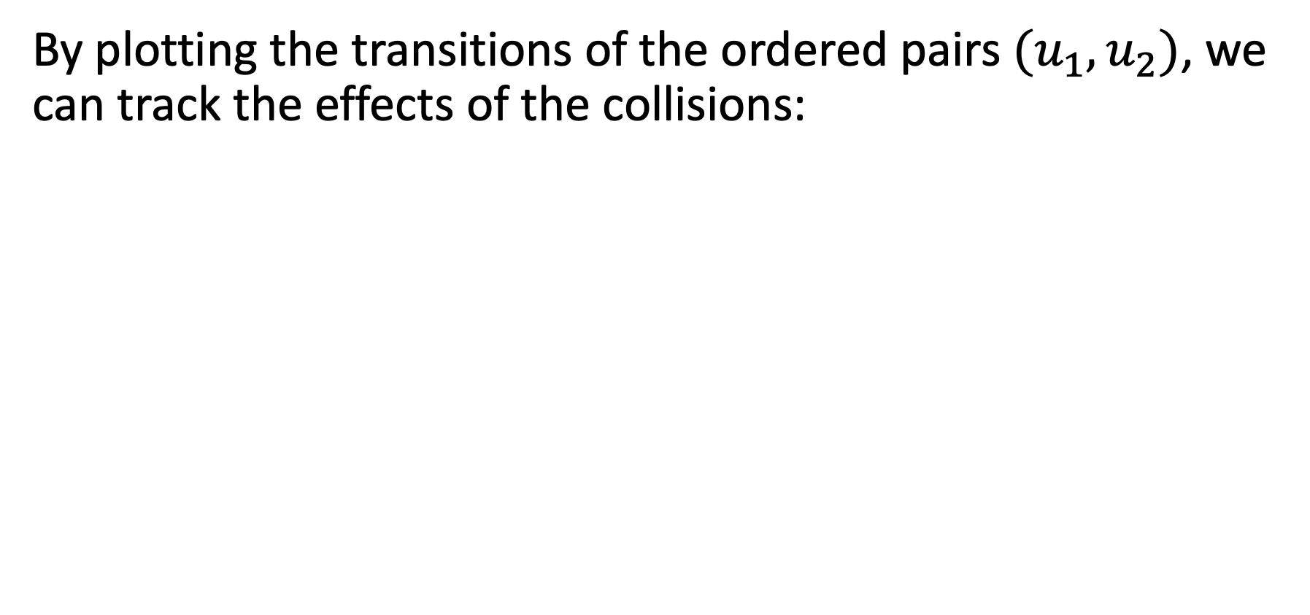

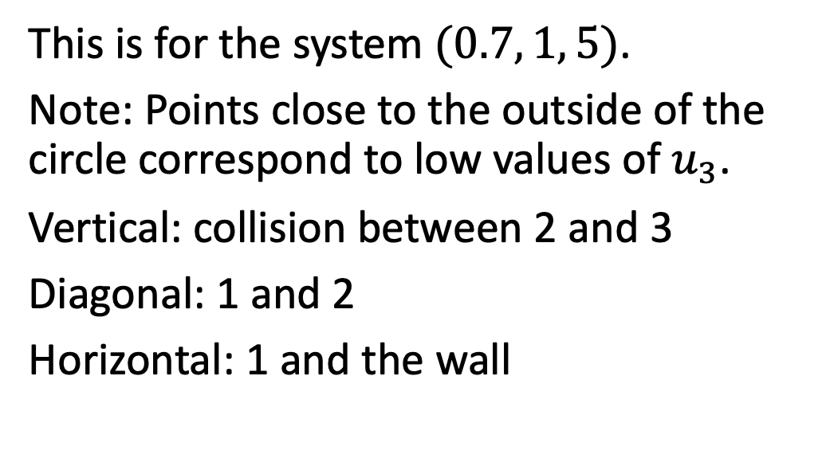
Phase planes for $(x,m_{2},m_{3})$ systems
By plotting the transitions of the ordered pairs $(u_{1},u_{2})$, we can track the effects of the collisions:
This is for the system $(0.7, 1, 5)$.
Note: Points close to the outside of the circle correspond to low values of $u_{3}$.
Vertical: collision between 2 and 3
Diagonal: 1 and 2
Horizontal: 1 and the wall

Slide 15
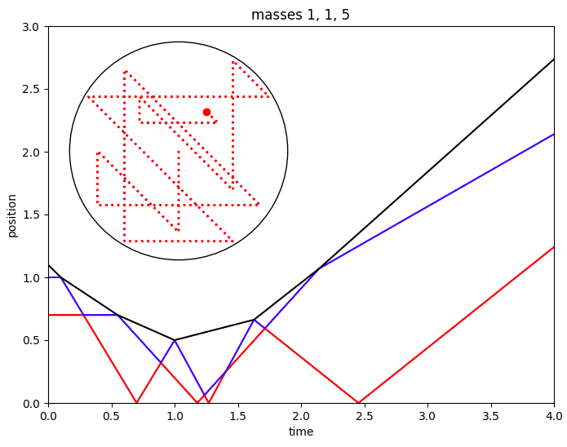
Phase planes
Combining the phase plane with a plot of positions vs. time makes it easier to see how this plays out …
Note that the final collision is not shown in this plot.

Slide 16
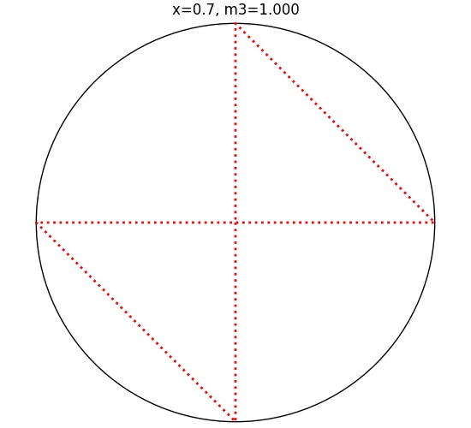
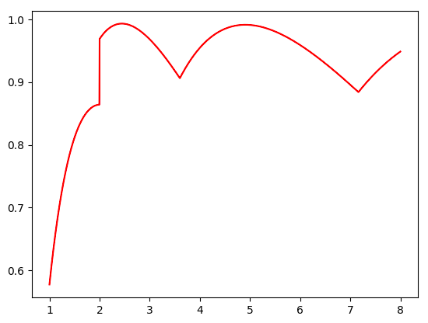
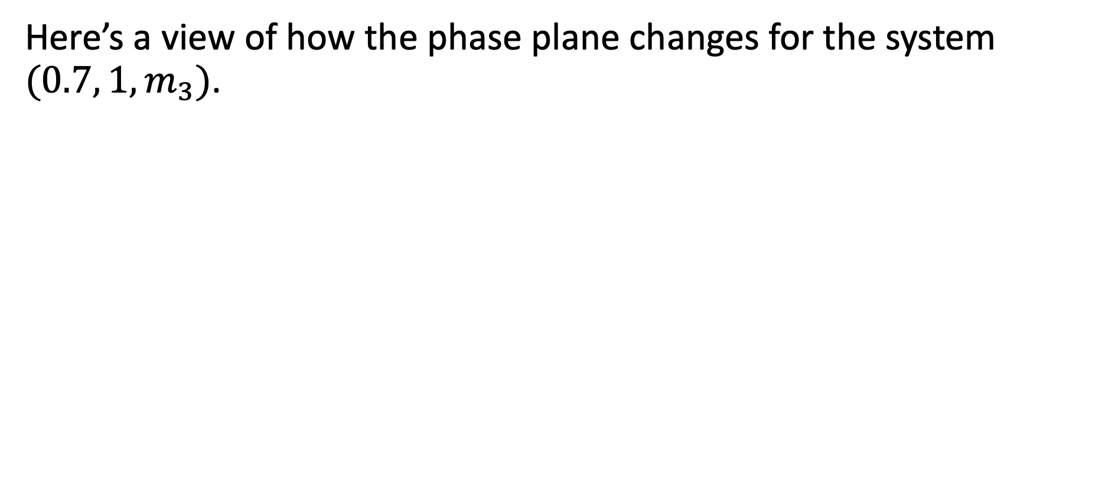
Phase planes
Here’s a view of how the phase plane changes for the system $(0.7, 1, m_{3})$.

Slide 17
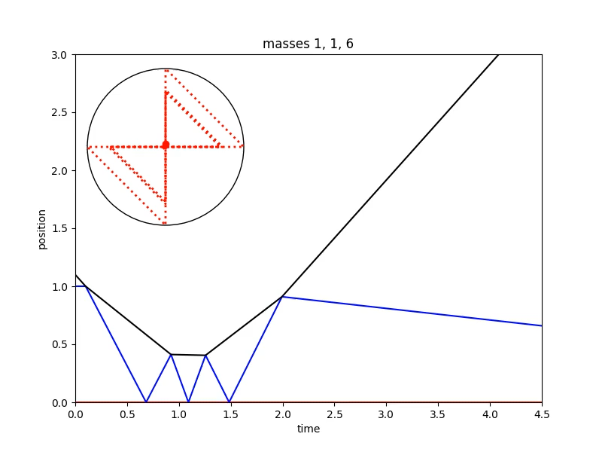
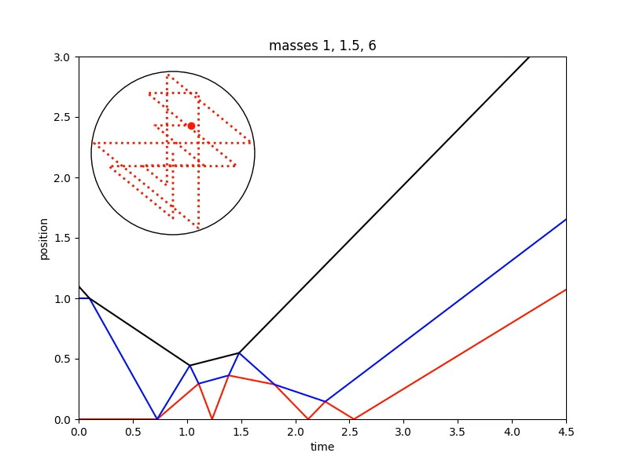
Why are there discontinuities?

Slide 18
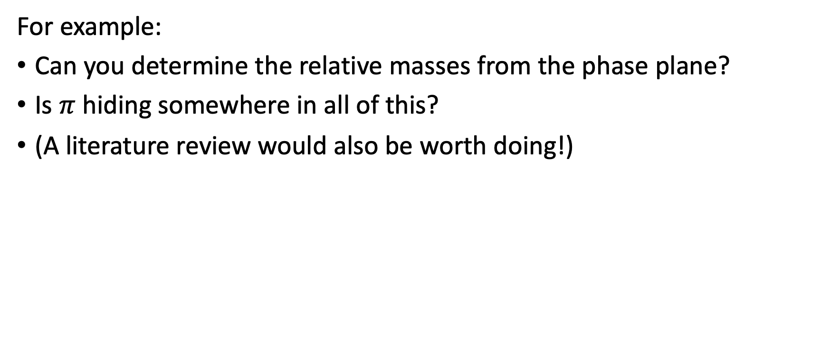
Lots of areas for exploration …
For example:
Can you determine the relative masses from the phase plane?
Is $π$ hiding somewhere in all of this?
(A literature review would also be worth doing!)

Slide 19



Gregory Galperin, “Playing pool with π (the number π from a billiard point of view).” Regular and Chaotic Dynamics, January 2003. https://tinyurl.com/pool-with-pi (redirects to researchgate.net).
3Blue1Brown (YouTube channel), “The most unexpected answer to a counting puzzle.” https://youtu.be/HEfHFsfGXjs.
Note the next video in the series covers Galperin’s proof, and also a second proof using a phase diagram.
https://github.com/darrylnester/billiard-dynamical-system (Python code to simulate and graph these systems)

Slide 20
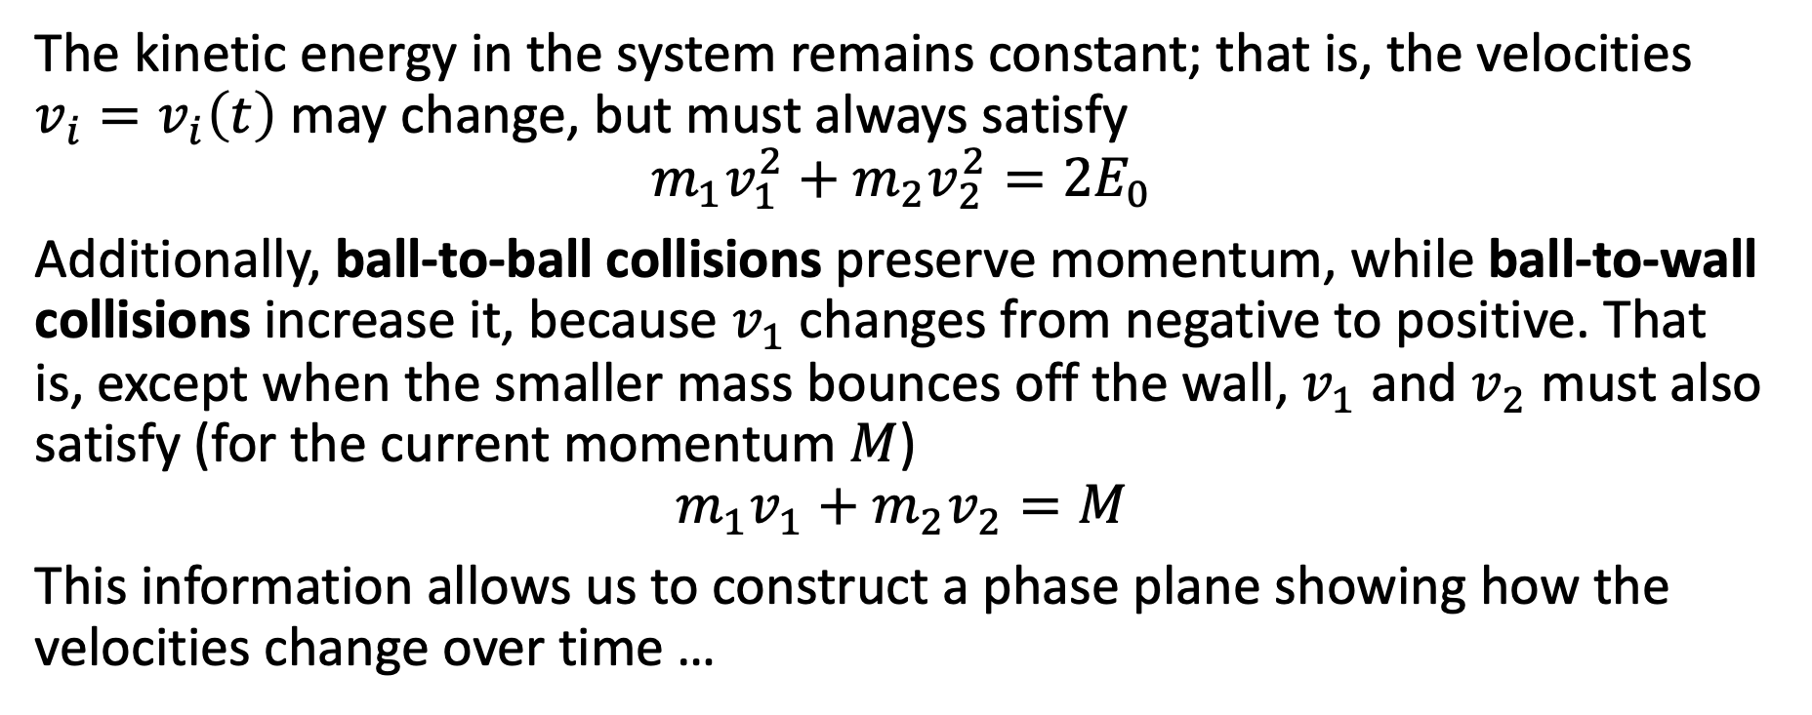
A proof using a velocity phase plane
The kinetic energy in the system remains constant; that is, the velocities $v_{i}=v_{i}\left(t\right)$ may change, but must always satisfy
$$m_{1}v_{1}^{2}+m_{2}v_{2}^{2}={2E}_{0}$$
Additionally, ball-to-ball collisions preserve momentum, while ball-to-wall collisions increase it, because $v_{1}$changes from negative to positive. That is, except when the smaller mass bounces off the wall, $v_{1}$ and $v_{2}$ must also satisfy (for the current momentum $M$)
$$m_{1}v_{1}+m_{2}v_{2}=M$$
This information allows us to construct a phase plane showing how the velocities change over time …

Slide 21
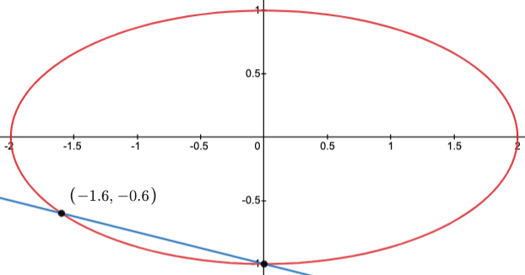
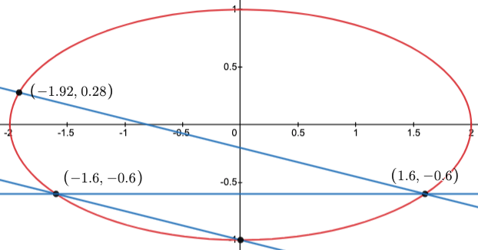
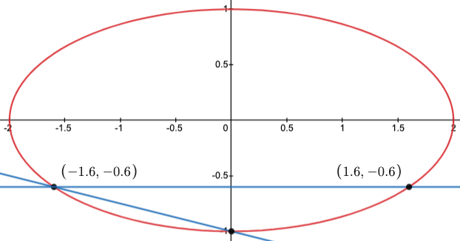
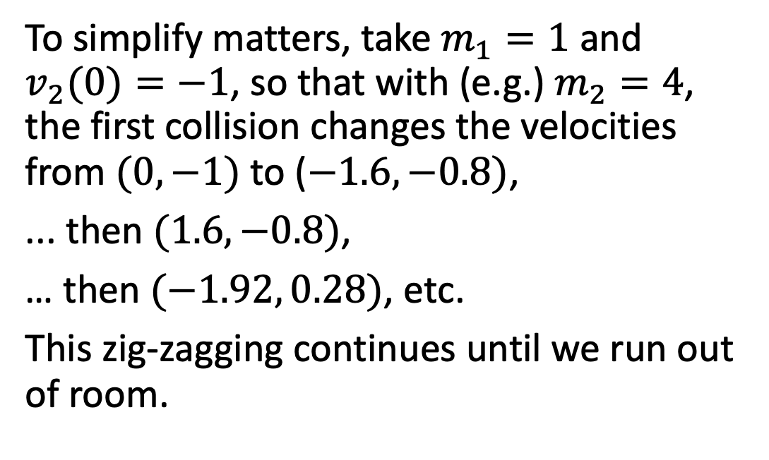
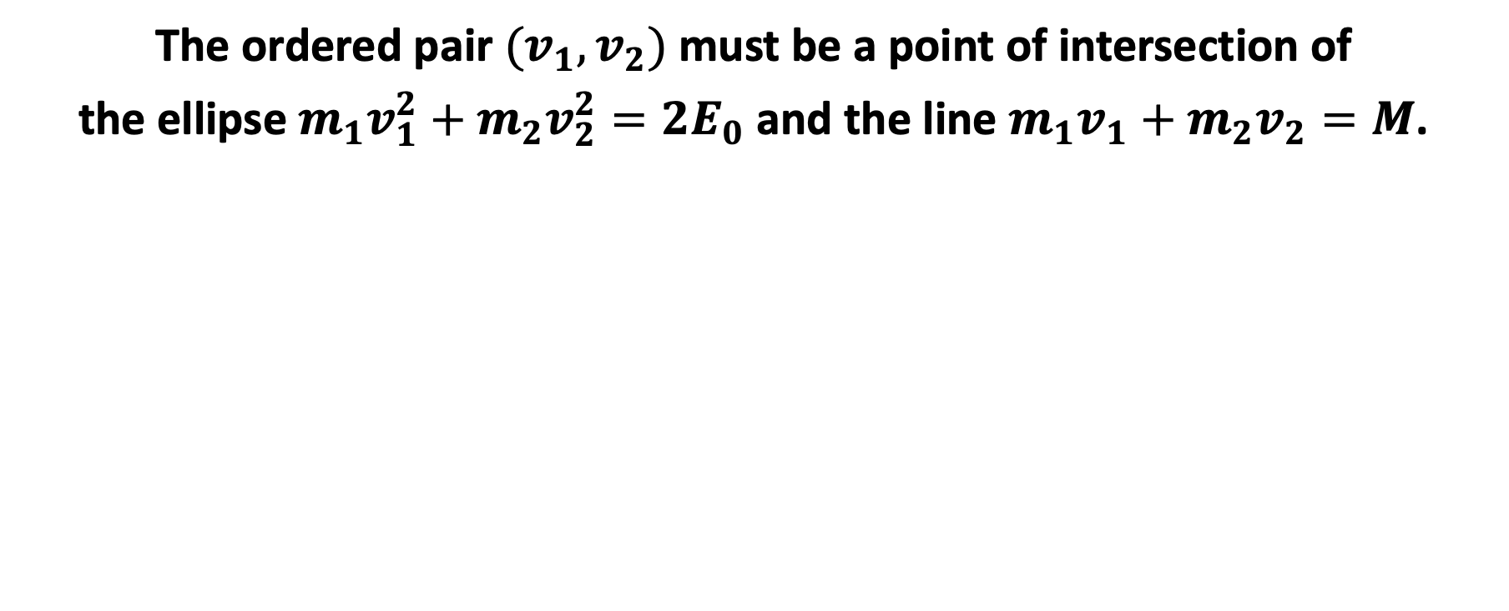
A proof using a velocity phase plane
The ordered pair $(v_{1},v_{2})$ must be a point of intersection of
the ellipse $m_{1}v_{1}^{2}+m_{2}v_{2}^{2}={2E}_{0}$ and the line $m_{1}v_{1}+m_{2}v_{2}=M$.
To simplify matters, take $m_{1}=1$ and $v_{2}(0)=−1$, so that with (e.g.) $m_{2}=4$, the first collision changes the velocities from $(0,−1)$to ($−1.6, −0.8)$,
... then $(1.6, −0.8)$,
… then $(−1.92, 0.28)$, etc.
This zig-zagging continues until we run out of room.

Slide 22
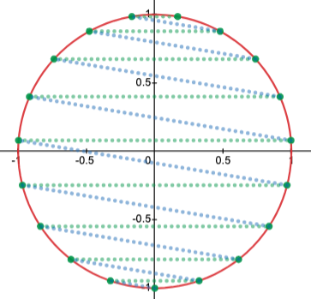
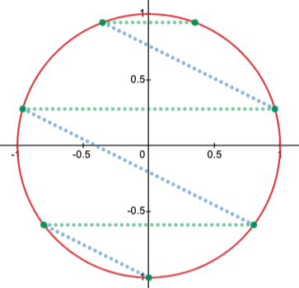
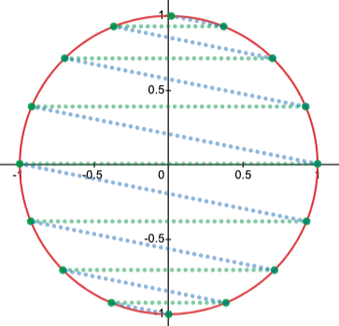
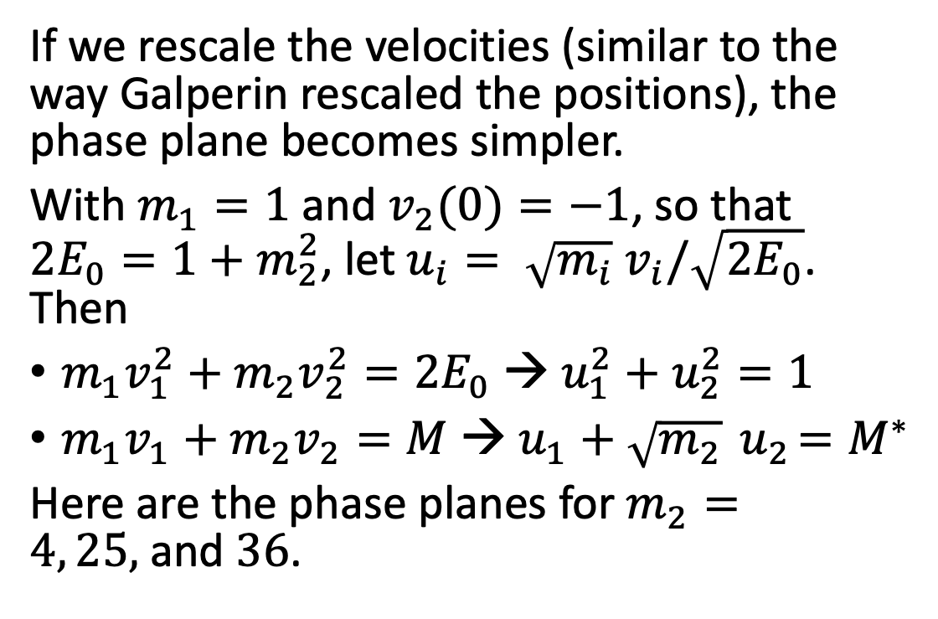
A proof using a velocity phase plane
If we rescale the velocities (similar to the way Galperin rescaled the positions), the phase plane becomes simpler.
With $m_{1}=1$ and $v_{2}(0)=−1$, so that ${2E}_{0}=1+m_{2}^{2}$, let $u_{i}= \sqrt{m_{i}} v_{i}/\sqrt{2E_{0}}$. Then
$m_{1}v_{1}^{2}+m_{2}v_{2}^{2}={2E}_{0}$ → $u_{1}^{2}+u_{2}^{2}=1$
$m_{1}v_{1}+m_{2}v_{2}=M$ → $u_{1}+\sqrt{m_{2}}{ u}_{2}=M^{∗}$
Here are the phase planes for $m_{2}=4, 25,$and $36$.

Slide 23
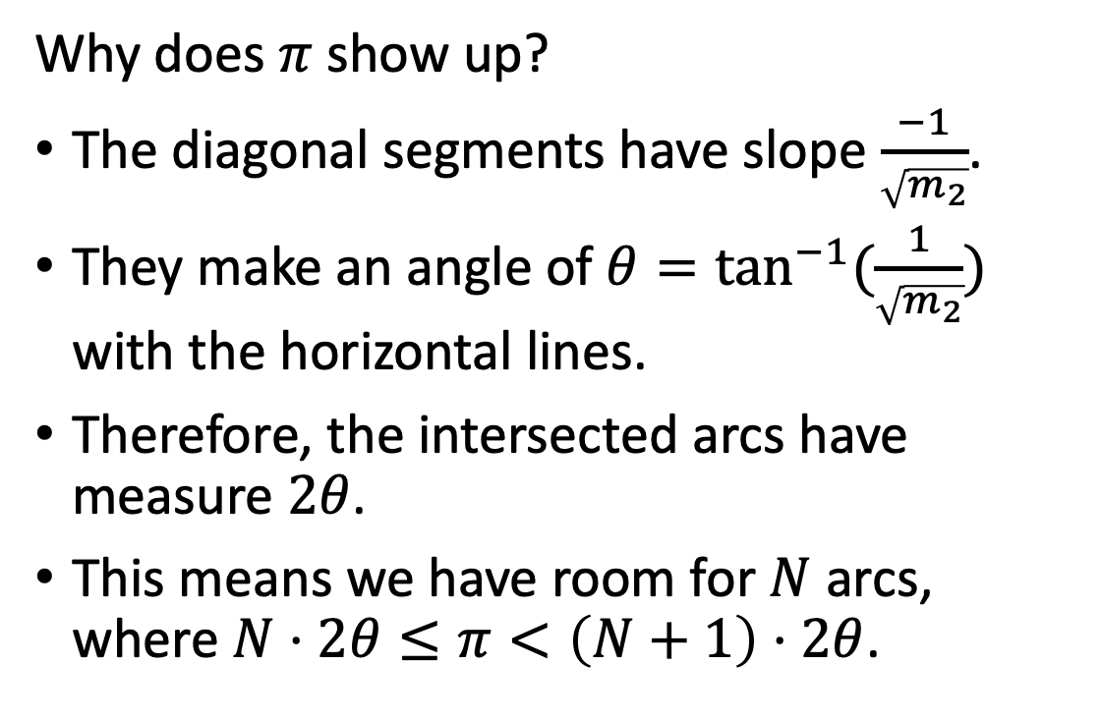
A proof using a velocity phase plane
Why does $π$show up?
The diagonal segments have slope $\frac{−1}{\sqrt{m_{2}}}$.
They make an angle of ${θ=tan}^{−1}{(\frac{1}{\sqrt{m_{2}}})}$ with the horizontal lines.
Therefore, the intersected arcs have measure $2θ$.
This means we have room for $N$ arcs, where $N⋅2θ≤π<\left(N+1\right)⋅2θ$.

